Slide 1

COMPUTER GRAPHICS
Hochiminh city University of Technology
Faculty of Computer Science and Engineering
CHAPTER 5 :
Viewing

Slide 2
OUTLINE
Classical Viewing
Orthographic Projection
Axonometric Projections
Oblique Projection
Perspective Projection
Computer Viewing
Projection
View volume
Projection Matrices
Orthogonal Projection
Oblique Projections
Perspective Projection

Slide 3
Classical Viewing
Introduce the classical views
Compare and contrast image formation by computer with how images have been formed by architects, artists, and engineers
Learn the benefits and drawbacks of each type of view

Slide 4
Classical Viewing
Viewing requires three basic elements
  One or more objects
  A viewer with a projection surface
  Projectors that go from the object(s) to the projection surface
Classical views are based on the relationship among these elements
  The viewer picks up the object and orients it how she would like to see it
Each object is assumed to constructed from flat principal faces
  Buildings, polyhedra, manufactured objects

Slide 5
Classical Viewing
Planar Geometric Projections
  Standard projections project onto a plane
  Projectors are lines that either
    converge at a center of projection
    are parallel
  Such projections preserve lines, but not necessarily angles
  Nonplanar projections are needed for applications such as map construction

Slide 6
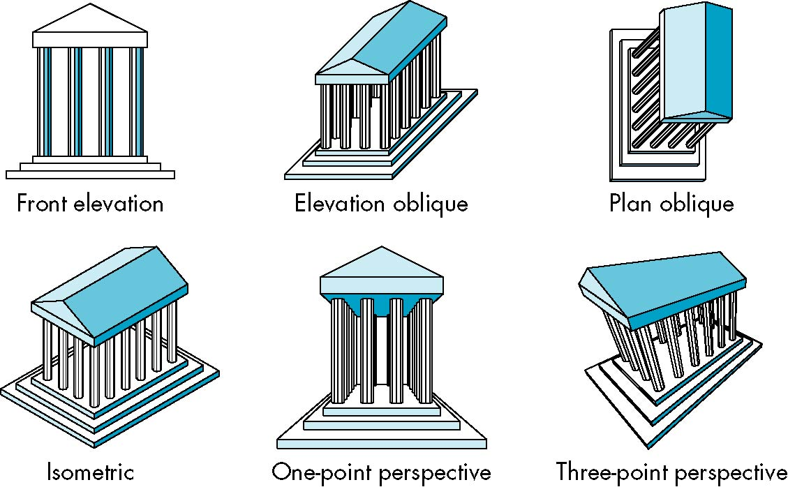
Classical Viewing
Classical Projections

Slide 7
Classical Viewing
Taxonomy of Planar Geometric Projections
planar geometric projections
parallel
perspective
1 point
2 point
3 point
multiview
orthographic
axonometric
oblique
isometric
dimetric
trimetric

Slide 8
Classical Viewing
Computer graphics treats all projections the same and implements them with a single pipeline
Classical viewing developed different techniques for drawing each type of projection
Fundamental distinction is between parallel and perspective viewing even though mathematically parallel viewing is the limit of perspective viewing

Slide 9
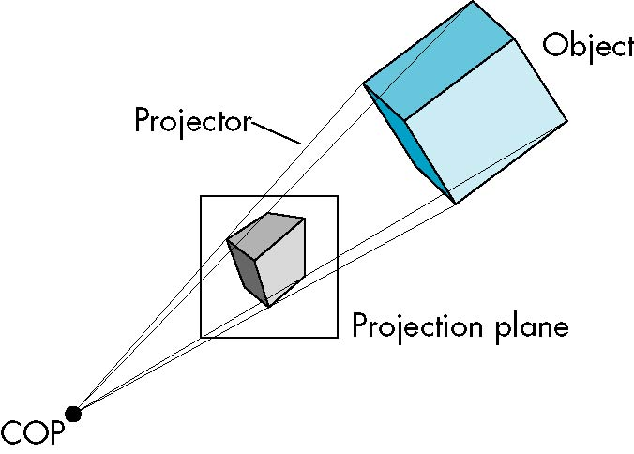
Classical Viewing
Perspective Projection

Slide 10
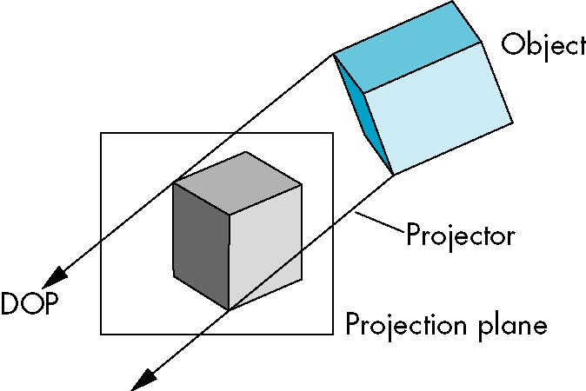
Classical Viewing
Parallel Projection

Slide 11
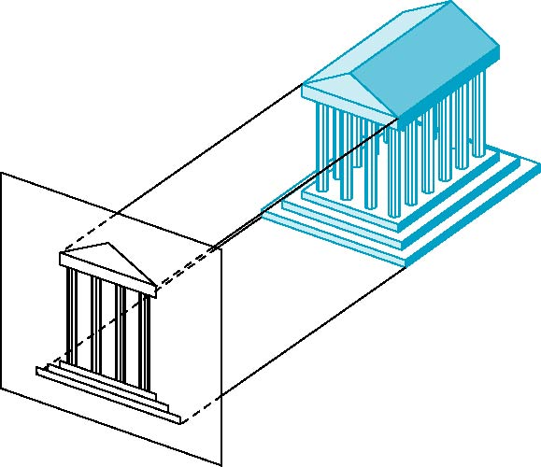
Orthographic Projection
Projectors are orthogonal to projection surface

Slide 12

Orthographic Projection
Multiview Orthographic Projection
  Projection plane parallel to principal face
  Usually form front, top, side views
isometric (not multiview
orthographic view)
front
in CAD and architecture,
we often display three
multiviews plus isometric
side
top

Slide 13
Orthographic Projection
Advantages
  Preserves both distances and angles
    Shapes preserved
    Can be used for measurements
      Building plans
      Manuals
Disadvantages
  Cannot see what object really looks like because many surfaces hidden from view
    Often we add the isometric

Slide 14
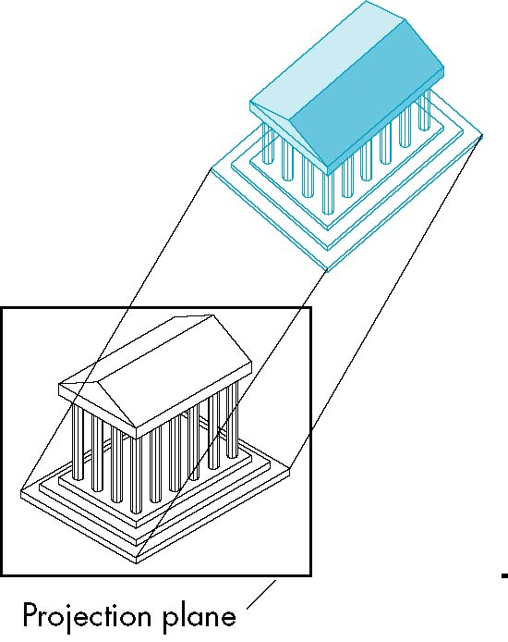
Axonometric Projections
Allow projection plane to move relative to object
  Classify by how many angles of a corner of a projected cube are the same
    none: trimetric
    two: dimetric
    three: isometric(trục đo – đều)

Slide 15
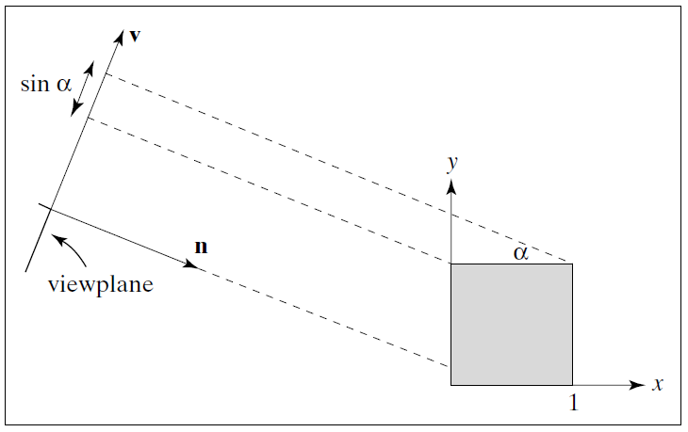
Axonometric Projections
Foreshortening factor
  Isometric (“equal measure”): All three principal axes are foreshortened equally
  Dimetric:
  Trimetric:

Slide 16

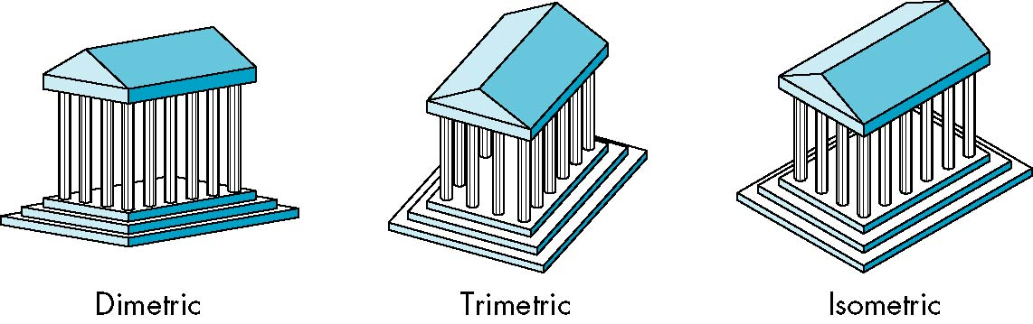
Axonometric Projections

Slide 17
Axonometric Projections
Lines are scaled (foreshortened) but can find scaling factors
Lines preserved but angles are not
  Projection of a circle in a plane not parallel to the projection plane is an ellipse
Can see three principal faces of a box-like object
Some optical illusions possible
  Parallel lines appear to diverge
Does not look real because far objects are scaled the same as near objects
Used in CAD applications

Slide 18
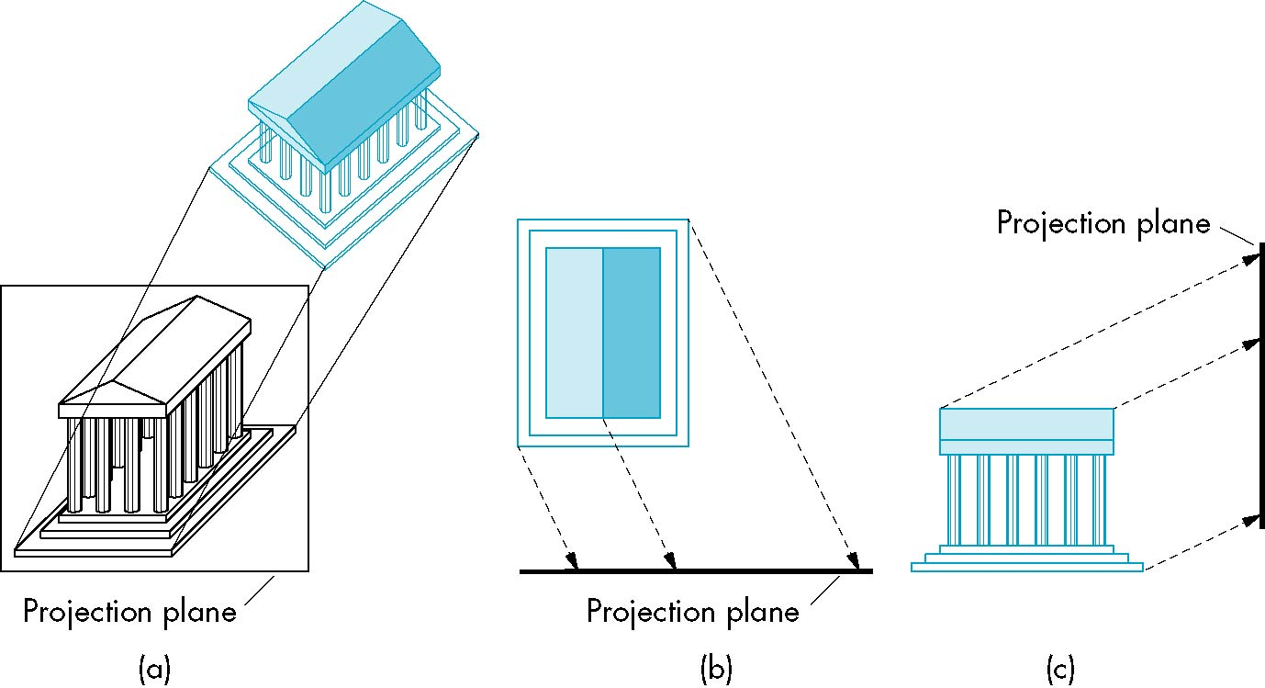
Oblique Projection
Arbitrary relationship between projectors and projection plane

Slide 19
Oblique Projection
Can pick the angles to emphasize a particular face
  Architecture: plan oblique, elevation oblique
Angles in faces parallel to projection plane are preserved while we can still see “around” side
In physical world, cannot create with simple camera; possible with bellows camera or special lens (architectural)

Slide 20
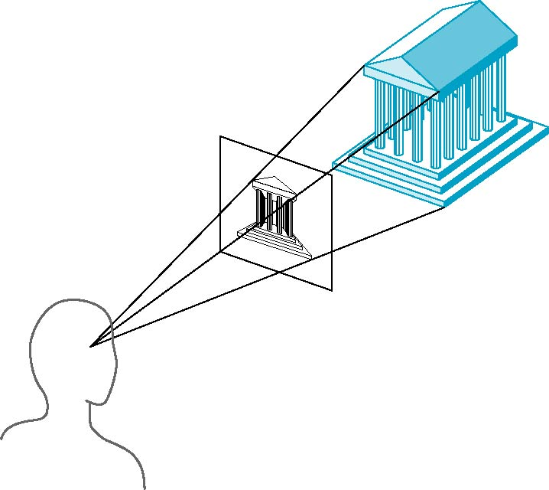
Perspective Projection
Projectors coverge at center of projection

Slide 21
Perspective Projection
Vanishing Points
  Parallel lines (not parallel to the projection plan) on the object converge at a single point in the projection (the vanishing point)
  Drawing simple perspectives by hand uses these vanishing point(s)
vanishing point

Slide 22
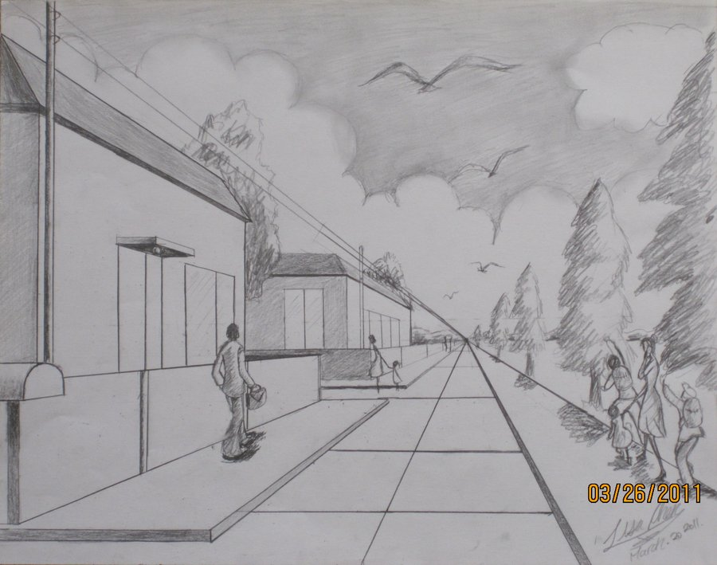
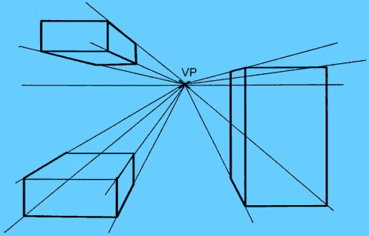
Perspective Projection
One-Point Perspective
  One principal face parallel to projection plane
  One vanishing point for cube

Slide 23
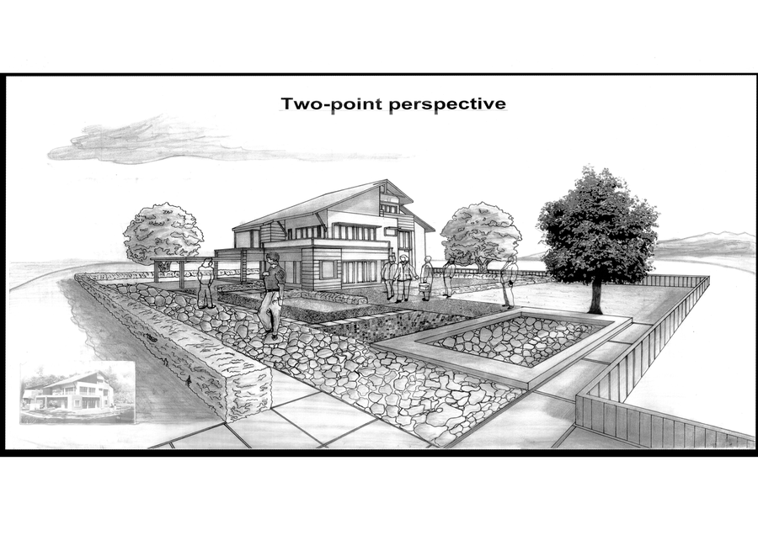
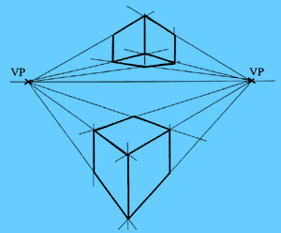
Perspective Projection
Two-Point Perspective
  On principal direction parallel to projection plane
  Two vanishing points for cube

Slide 24
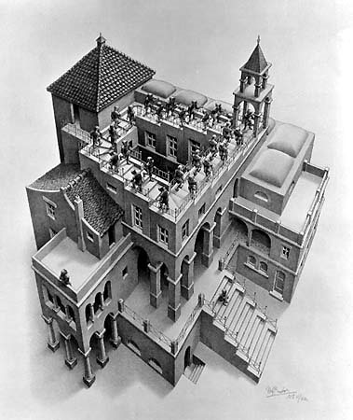
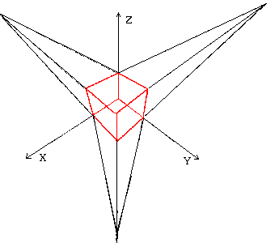
Perspective Projection
Three-Point Perspective
  No principal face parallel to projection plane
  Three vanishing points for cube

Slide 25
Perspective Projection
Objects further from viewer are projected smaller than the same sized objects closer to the viewer (diminution)
  Looks realistic
Equal distances along a line are not projected into equal distances (nonuniform foreshortening)
Angles preserved only in planes parallel to the projection plane
More difficult to construct by hand than parallel projections (but not more difficult by computer)

Slide 26
Computer Viewing
There are three aspects of the viewing process, all of which are implemented in the pipeline,
  Positioning the camera
    Setting the model-view matrix
  Selecting a lens
    Setting the projection matrix
  Clipping
    Setting the view volume

Slide 27
Computer Viewing
In OpenGL, initially the object and camera frames are the same
  Default model-view matrix is an identity
The camera is located at origin and points in the negative z direction
OpenGL also specifies a default view volume that is a cube with sides of length 2 centered at the origin
  Default projection matrix is an identity

Slide 28
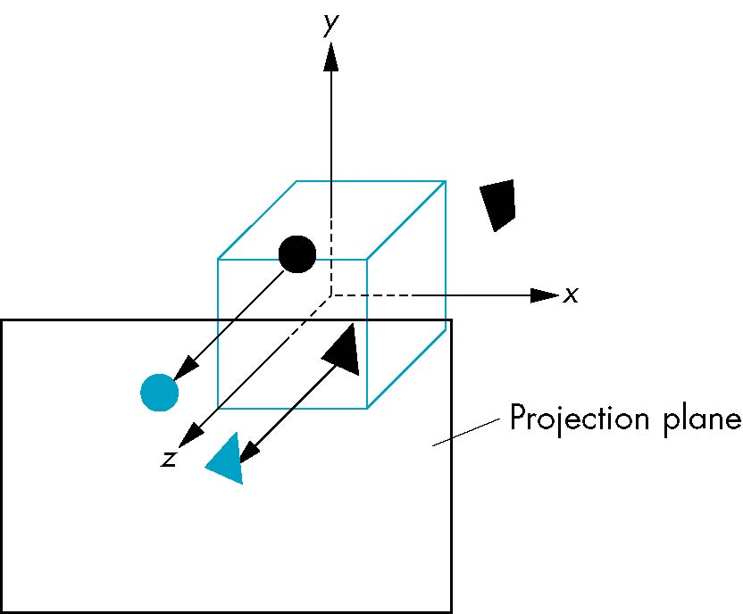
Computer Viewing
Default projection is orthogonal
clipped out
z=0

Slide 29
Computer Viewing
If we want to visualize object with both positive and negative z values we can either
  Move the camera in the positive z direction
    Translate the camera frame
  Move the objects in the negative z direction
    Translate the world frame
Both of these views are equivalent and are determined by the model-view matrix
  Want a translation (glTranslatef(0.0,0.0,-d);)
  d > 0

Slide 30
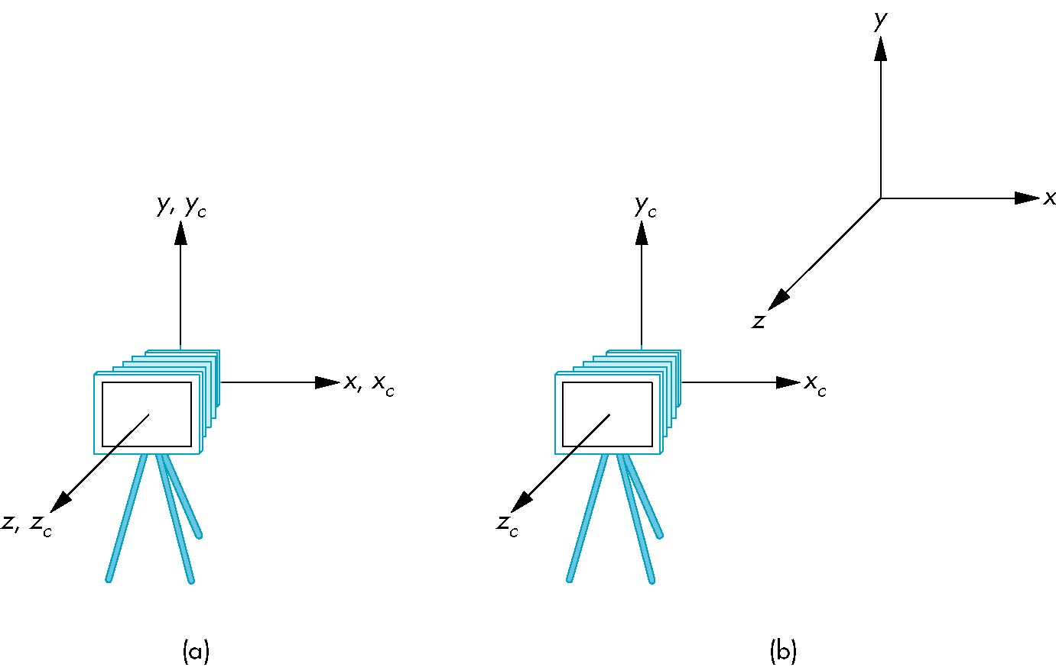
Computer Viewing
frames after translation by –d
d > 0
default frames

Slide 31
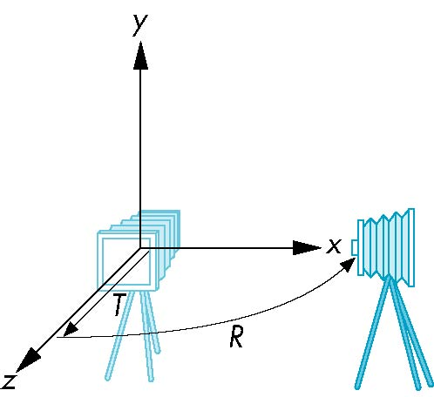
Computer Viewing
We can move the camera to any desired position by a sequence of rotations and translations
Example: side view
  Rotate the camera
  Move it away from origin
  Model-view matrix C = TR

Slide 32
Computer Viewing
Remember that last transformation specified is first to be applied
glMatrixMode(GL_MODELVIEW)
glLoadIdentity();
glTranslatef(0.0, 0.0, -d);
glRotatef(90.0, 0.0, 1.0, 0.0);

Slide 33
Computer Viewing
The GLU library contains the function gluLookAt to form the required modelview matrix through a simple interface
Note the need for setting an up direction
Still need to initialize
  Can concatenate with modeling transformations
Example: isometric view of cube aligned with axes
glMatrixMode(GL_MODELVIEW):
glLoadIdentity();
gluLookAt(1.0, 1.0, 1.0, 0.0, 0.0, 0.0,
0.0, 1.0. 0.0);

Slide 34
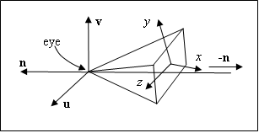
Computer Viewing
Set up position & direction of camera
glMatrixMode(GL_MODELVIEW);
glLoadIdentity();
gluLookAt(eye.x,eye.y,eye.z,look.x,look.y,look.z,
up.x,u p.y,up.z);

Slide 35
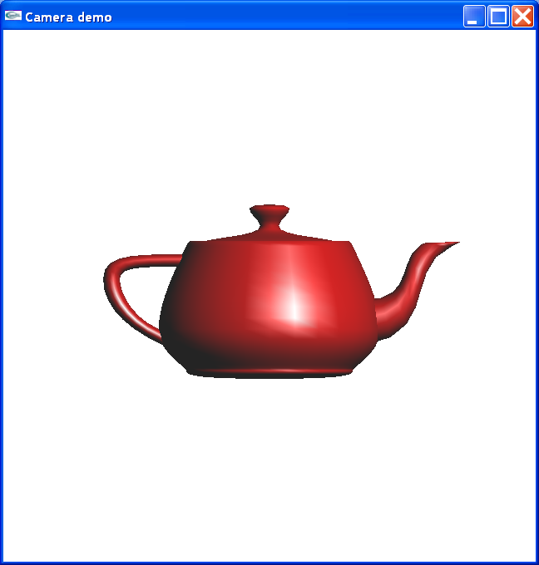
Computer Viewing
Set up position & direction of camera
gluLookAt(0, 0, 10, 0.0, 0.0, 0.0, 0.0, 1.0, 0.0);

Slide 36
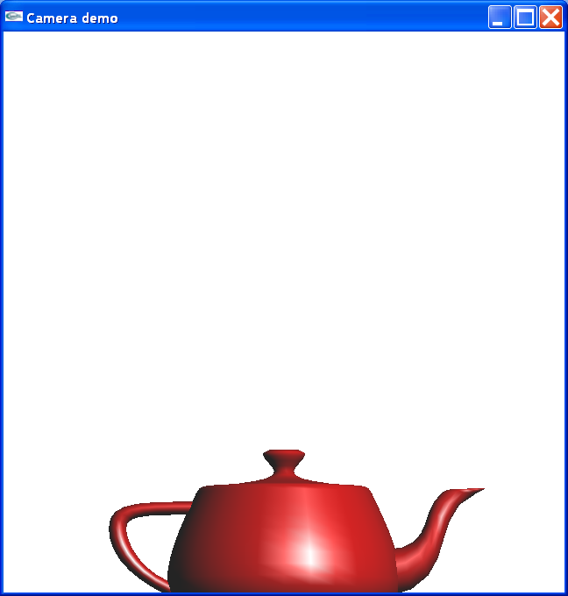
Computer Viewing
Set up position & direction of camera
  gluLookAt(0, 0, 10, 0.0, 1.0, 0.0, 0.0, 1.0, 0.0);

Slide 37
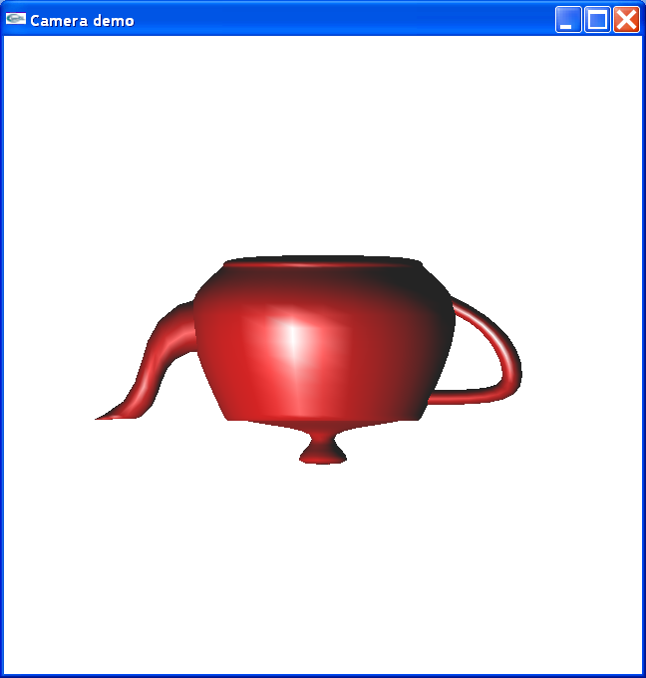
Computer Viewing
Set up position & direction of camera
  gluLookAt(0, 0, 10, 0.0, 0.0, 0.0, 0.0, -1.0, 0.0);

Slide 38
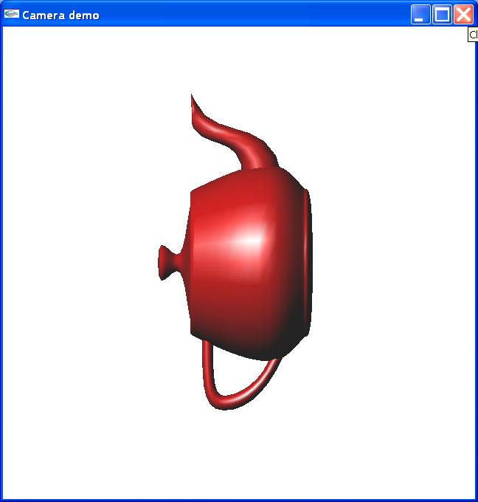
Computer Viewing
Set up position & direction of camera
  gluLookAt(0, 0, 10, 0.0, 0.0, 0.0, 1.0, 0.0, 0.0);

Slide 39
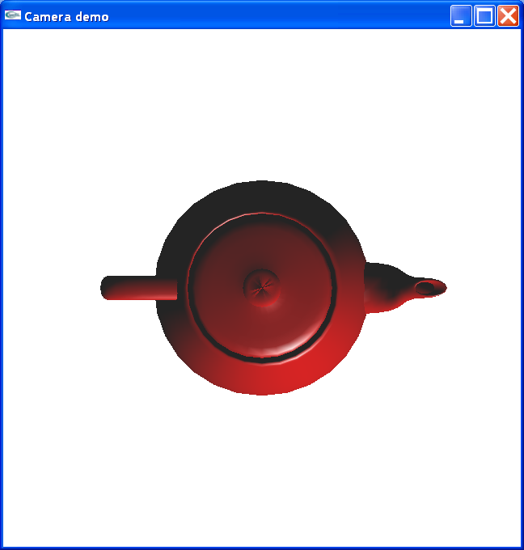
Computer Viewing
Set up position & direction of camera
  gluLookAt(0, 10, 0, 0.0, 0.0, 0.0, 0.0, 0.0, -1.0);

Slide 40
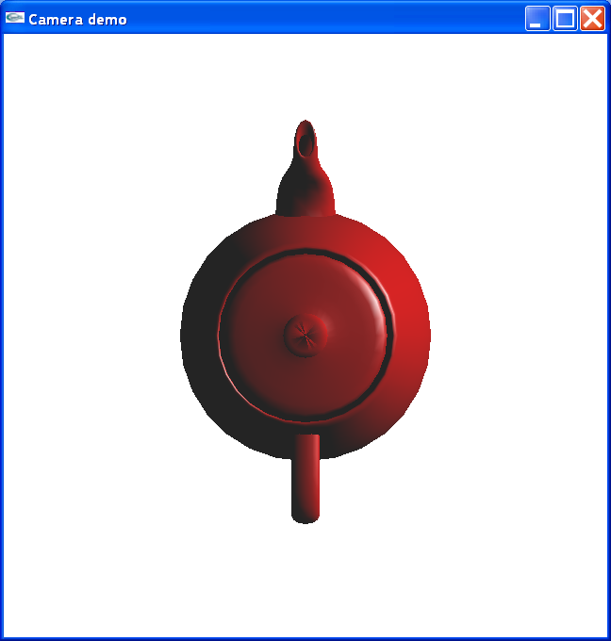
Computer Viewing
Set up position & direction of camera
  gluLookAt(0, 10, 0, 0.0, 0.0, 0.0, 1.0, 0.0, 0.0);

Slide 41
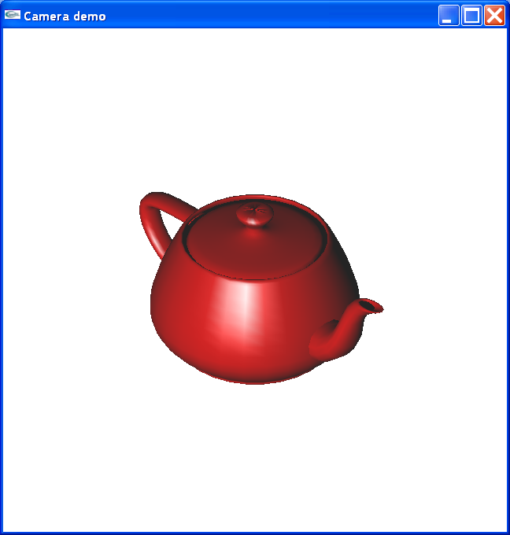
Computer Viewing
Set up position & direction of camera
  gluLookAt(10, 10, 10, 0.0, 0.0, 0.0, 0.0, 1.0, 0.0);

Slide 42
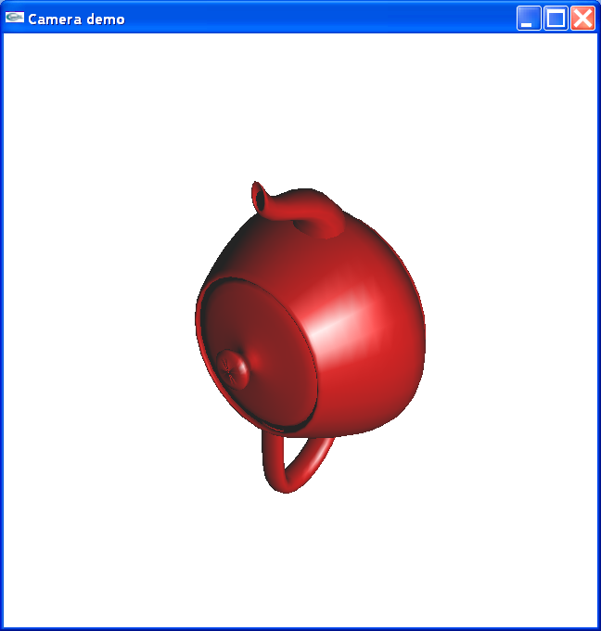
Computer Viewing
Set up position & direction of camera
  gluLookAt(10, 10, 10, 0.0, 0.0, 0.0, 1.0, 0.0, 0.0);

Slide 43
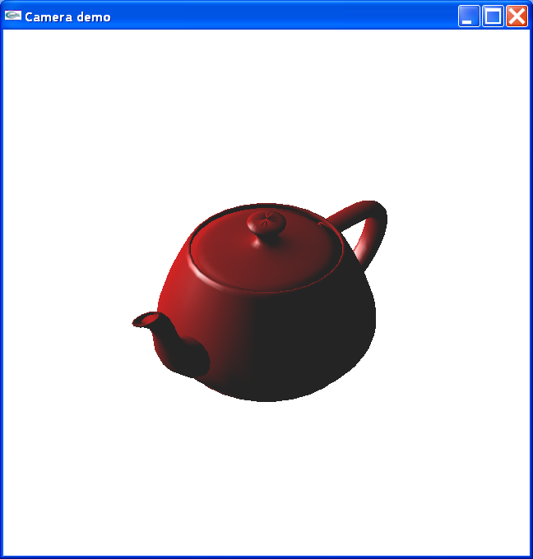
Computer Viewing
Set up position & direction of camera
  gluLookAt(10, 10, -10, 0.0, 0.0, 0.0, 0.0, 1.0, 0.0);

Slide 44
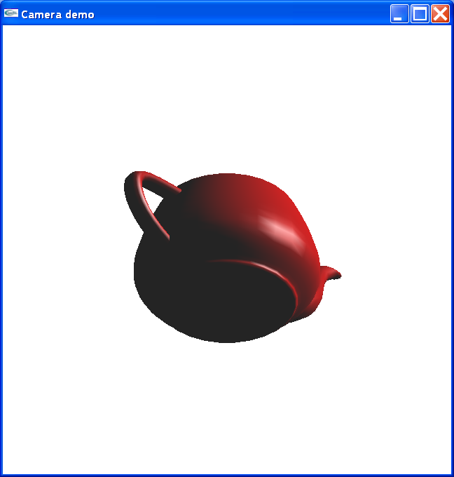
Computer Viewing
Set up position & direction of camera
  gluLookAt(-10, -10, 10, 0.0, 0.0, 0.0, 0.0, 1.0, 0.0);

Slide 45
Computer Viewing
Set up position & direction of camera
a) pitch
b) roll
c) yaw
v
u
n
u
n
a)
b)
c)
v
v
v
u
u
u
n

Slide 46
Computer Viewing
Matrix transfrom from wordld frame to camera frame
  eye, look at, up → u, v, n
  n = eye – look.
  u = up×n,
  v = n×u
  u, v, n : unit vector
v
up
up
n
eye
eye
look
u
look

Slide 47
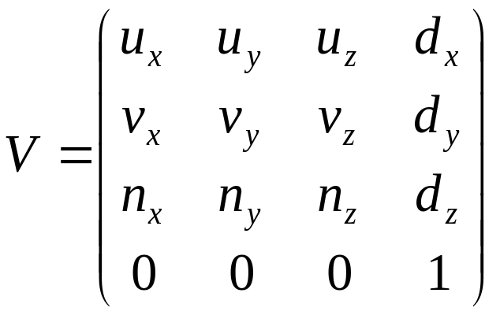
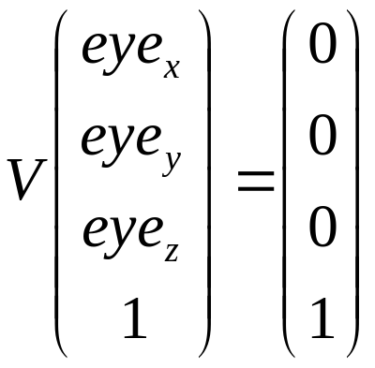
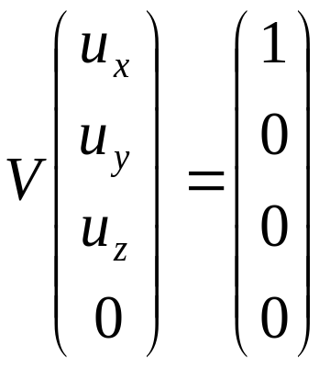
Computer Viewing
Matrix transfrom from wordld frame to camera frame
  CTM = V.M
(d_{x}, d_{y}, d_{z}) = (-eye • u, -eye • v, -eye • n)
v
n
u
y
V
eye
z
x

Slide 48
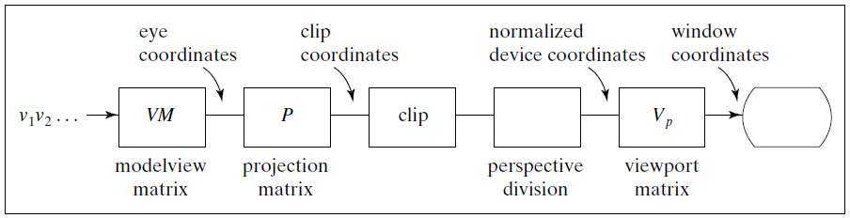
Computer Viewing

Slide 49
Projection
Orthogonal projection
  The default projection in the eye (camera) frame is orthogonal
  For points within the default view volume
  x_{p} = x
  y_{p} = y
  z_{p} = 0

Slide 50
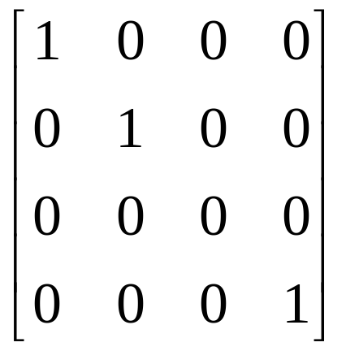
Projection
Orthogonal projection
default orthographic projection
x_{p} = x
y_{p} = y
z_{p} = 0
w_{p} = 1
p_{p} = Mp
M =

Slide 51
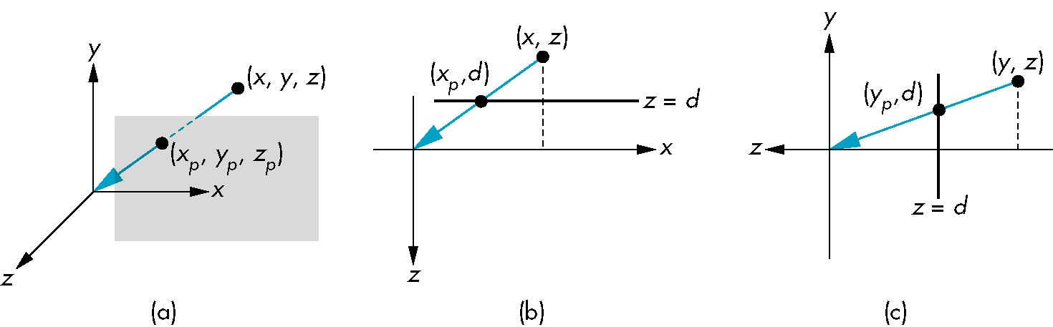
Projection
Perspective Projection
  Center of projection at the origin
  Projection plane z = d, d < 0

Slide 52
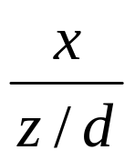
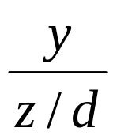
Projection
Perspective Projection
  Consider top and side views
x_{p} =
y_{p} =
z_{p} = d

Slide 53
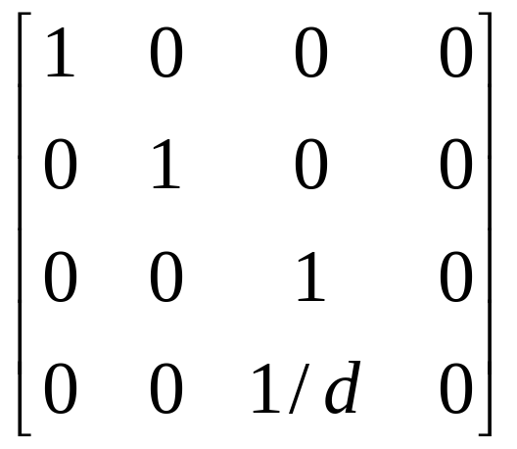
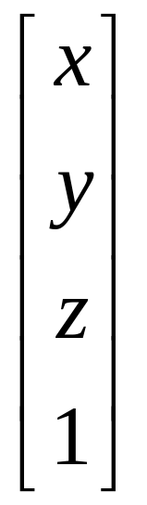
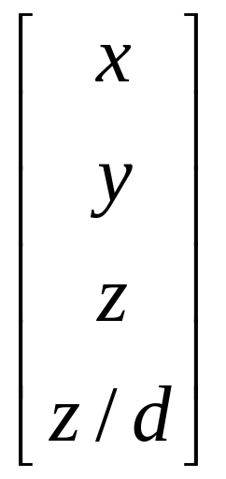
Projection
Perspective Projection
consider q = Mp where
M =
p =
⇒ q =

Slide 54
Projection
Perspective Projection
  However w ≠ 1, so we must divide by w to return from homogeneous coordinates
  This perspective division yields
  the desired perspective equations
x_{p} =
y_{p} =
z_{p} = d

Slide 55
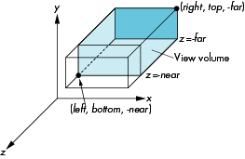
View volume
Orthogonal projection
  glOrtho(left,right,bottom,top,near,far)
  near and far measured from camera

Slide 56
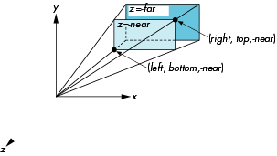
View volume
Perspective Projection
  glFrustum(left,right,bottom,top,near,far)

Slide 57
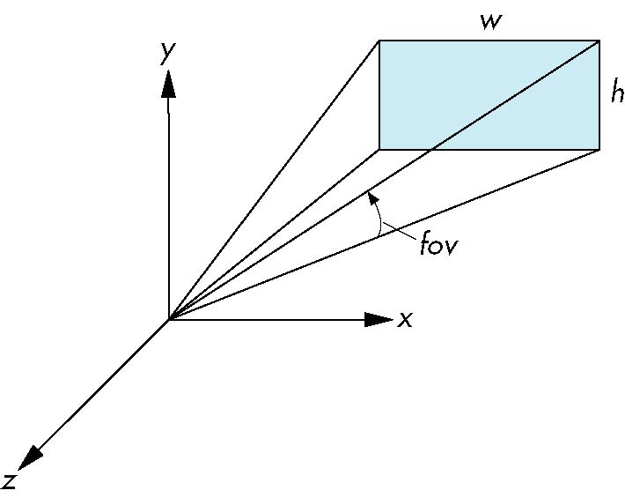
View volume
Perspective Projection
  With glFrustum it is often difficult to get the desired view
  gluPerpective(fovy, aspect, near, far) often provides a better interface
front plane
aspect = w/h

Slide 58
Projection Matrices

Slide 59
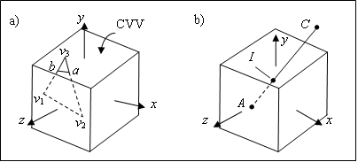
Projection Matrices
Clip coordinates:
  Check whether objects lie within view volume
  Projection transformation: brings objects into a cube centered at the origin.
Perspective division: divide by w component

Slide 60
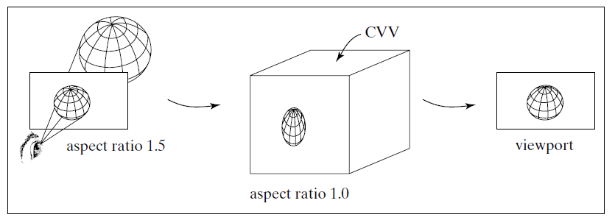
Projection Matrices
The viewport transformation restore the aspect ratio of an object

Slide 61
Projection Matrices
Derive the projection matrices used for standard OpenGL projections
Introduce oblique projections
Introduce projection normalization

Slide 62
Projection Matrices
Normalization
  Rather than derive a different projection matrix for each type of projection, we can convert all projections to orthogonal projections with the canonical view volume
  This strategy allows us to use standard transformations in the pipeline and makes for efficient clipping

Slide 63
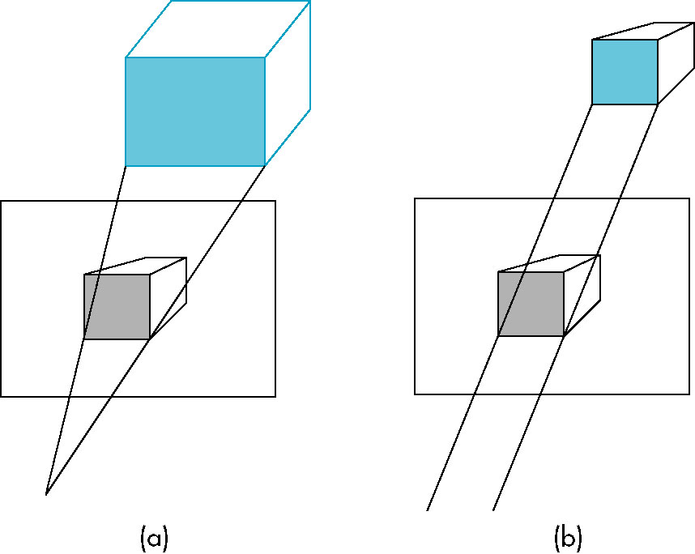
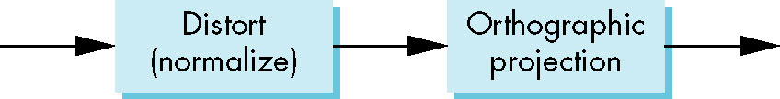
Projection Matrices
Normalization

Slide 64
Projection Matrices
(Persp. Projection) = (Persp. Transformation.) + (Ortho. Projection)
  Consistency
  Easy for clip

Slide 65
Projection Matrices
Normalization
  We stay in four-dimensional homogeneous coordinates through both the modelview and projection transformations
    Both these transformations are nonsingular
    Default to identity matrices (orthogonal view)
  Normalization lets us clip against simple cube regardless of type of projection
  Delay final projection until end
    Important for hidden-surface removal to retain depth information as long as possible

Slide 66
Projection Matrices
Normalization
modelview
transformation
projection
transformation
perspective
division
4D → 3D
nonsingular
clipping
projection
3D → 2D
against default cube

Slide 67
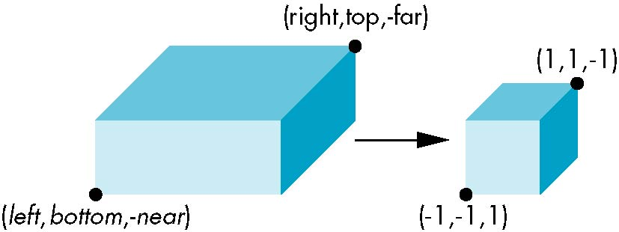
Orthogonal Projection
glOrtho(left,right,bottom,top,near,far)
normalization ⇒ find transformation to convert specified clipping volume to default
Flip: -far → 1; -near → 1
0 < near < far

Slide 68
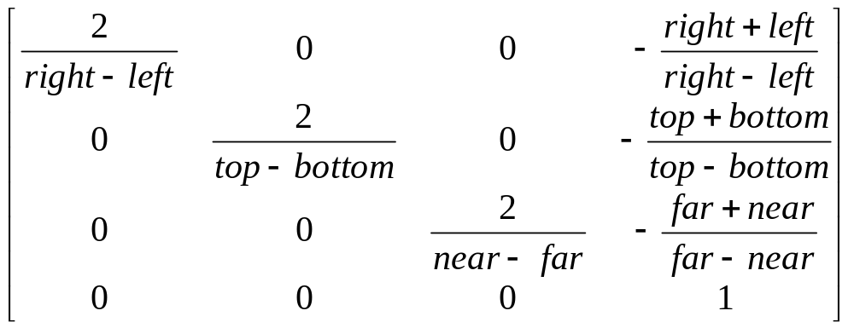
Orthogonal Projection
Two steps
  Move center to origin
    T(-(left+right)/2, -(bottom+top)/2,(near+far)/2))
  Scale to have sides of length 2
    S(2/(right-left),2/(top-bottom),2/(near-far))
P = ST =

Slide 69

Orthogonal Projection
Final Projection
  Set z =0
  Equivalent to the homogeneous coordinate transformation
  Hence, general orthogonal projection in 4D is
M_{orth} =
P = M_{orth}ST

Slide 70
Orthogonal Projection
Set up projection matrix in the pipeline
  Method 1
  glMatrixMode(GL_PROJECTION);
  glLoadIdentity();
  glOrtho(-1.2, 1.2, -1.2, 1.2, 0.1, 100);

Slide 71
Orthogonal Projection
Set up projection matrix in the pipeline
  Method 2
    float m[16];
  …………………..//Calculate m
  glMatrixMode(GL_PROJECTION);
  glLoadMatrixf(m);

Slide 72
Orthogonal Projection
Set up projection matrix in the pipeline
  Method 3
    glMatrixMode(GL_PROJECTION);
    glLoadIdentity();
    …………… //Calculate S matrix
    glMultMatrixf(s);
    …………… //Calculate T matrix
    glMultMatrixf(t);

Slide 73
Oblique Projections
The OpenGL projection functions cannot produce general parallel projections such as
However if we look at the example of the cube it appears that the cube has been sheared
Oblique Projection = Shear + Orthogonal Projection

Slide 74
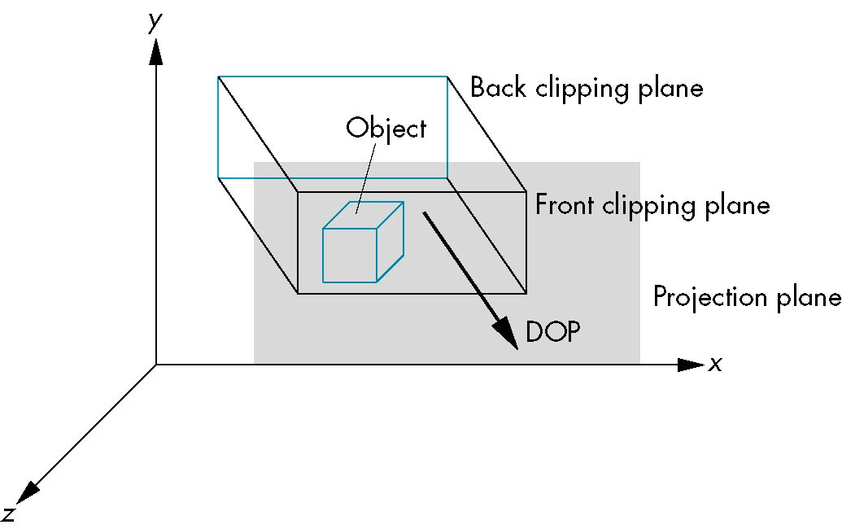

Oblique Projections
top view
side view

Slide 75

Oblique Projections
Shear matrix
xy shear (z values unchanged)
Projection matrix
H(θ,φ) =
P = M_{orth} H(θ,φ)

Slide 76

Oblique Projections

Slide 77
Oblique Projections
The projection matrix P = STH transforms the original clipping volume to the default clipping volume
object
top view
z = 1
DOP
DOP
x = -1
x = 1
far plane
z = -1
clipping
volume
near plane
distorted object
(projects correctly)

Slide 78

Perspective Projection
Simple case
Consider a simple perspective with the COP at the origin, the near clipping plane at z = -1, and a 90 degree field of view determined by the planes x = ±z,
y = ±z

Slide 79

Perspective Projection
Simple case
  Simple projection matrix in homogeneous coordinates
  Note that this matrix is independent of the far clipping plane
M =

Slide 80

Perspective Projection
General
distorted object
projects correctly
original object
new clipping
volume

Slide 81



Perspective Projection
General
If we pick
α =
N =
β =
0 < near < far
the near plane is mapped to z = -1
the far plane is mapped to z =1
and the sides are mapped to x = ± 1, y = ± 1
Hence the new clipping volume is the default clipping volume

Slide 82

Perspective Projection
glFrustum allows for an unsymmetric viewing frustum (although gluPerspective does not)

Slide 83
Perspective Projection
The normalization in glFrustum requires an initial shear to form a right viewing pyramid, followed by a scaling to get the normalized perspective volume. Finally, the perspective matrix results in needing only a final orthogonal transformation
P = NSH
our previously defined
perspective matrix
shear and scale

Slide 84

Perspective Projection
0 < near < far

Slide 85
Viewing
Changing the object
Changing the camera

Slide 86

Viewing
Changing object
  Use default camera
  Use glRotated, glTranslated to change object’s position and direction
glMatrixMode(GL_MODELVIEW);
glLoadIdentity();
glTranslated(0, 0, -5);
glRotated(45, 0, 0, 1);
glutSolidTeapot(1);

Slide 87
Viewing
Changing the camera
  Use gluLookAt
glMatrixMode(GL_MODELVIEW);
glLoadIdentity();
gluLookAt(0, 0, 5, 0.0, 0.0, 0.0, 1.0, 1.0, 0.0);

Slide 88
Building Camera class
v
up
up
n
eye
eye
look
u
look

Slide 89
Building Camera class
a) pitch
b) roll
c) yaw
v
u
n
u
n
a)
b)
c)
v
v
v
u
u
u
n

Slide 90
Building Camera class
class Camera {
private:
Point3 eye;
Vector3 u, v, n;
double viewAngle, aspect, nearDist, farDist;
void setModelViewMatrix();
public:
Camera();
void set(Point3 Eye, Point3 look, Vector3 up);
void roll(float angle);
void pitch(loat angle);
void yaw(float angle);
void slide(float delU, float delV, float delN);
void setShape(float vAng,float asp,float nearD,float farD);
};

Slide 91
Building Camera class
void Camera :: setModelViewMatrix(){
float m[16];
Vector3 eVec(eye.x, eye.y, eye.z);
m[0] = u.x ; m[4] = u.y; m[8] = u.z; m[12] = -eVec.dot(u);
m[1] = v.x ; m[5] = v.y; m[9] = v.z; m[13] = -eVec.dot(v);
m[2] = n.x ; m[6] = n.y; m[10] = n.z; m[14] = -eVec.dot(n);
m[3] = 0 ; m[7] = 0 ; m[11] = 0 ; m[15] = 1.0;
glMatrixMode(GL_MODELVIEW);
glLoadMatrixf(m);
}

Slide 92
Building Camera class
void Camera :: set(Point3 Eye, Point3 look, Vector3 up){
eye.set(Eye);
n.set(eye.x – look.x, eye.y – look.y, eye.z – look.z);
u.set(up.cross(n));
n.normalize();
u.normalize();
v.set(n.cross(u));
setModelViewMatrix();
}

Slide 93
Building Camera class
Translate camera along u, v and n.
void Camera :: slide(float delU, float delV, float delN){
eye.x += delU*u.x + delV*v.x + delN*n.x;
eye.y += delU*u.y + delV*v.y + delN*n.y;
eye.z += delU*u.z + delV*v.z + delN*n.z;
setModelViewMatrix();
}

Slide 94
Building Camera class
Rotate camera
  pitch (rotate about u), roll (rotate about n),
  yaw (rotate about v).
u’ = cos(α)u + sin(α)v,
v’ = -sin(α)u + cos(α)v,
v
v’
u’
α
u
void Camera :: roll (float angle){
float cs = cos(3.14159265/180 * angle);
float sn = sin(3.14159265/180 * angle);
Vector3 t = u;
u.set(cs*t.x – sn*v.x, cs*t.y – sn*v.y, cs*t.z – sn*v.z);
v.set(sn*t.x + cs*v.x, sn*t.y + cs*v.y, sn*t.z + cs*v.z);
setModelViewMatrix();}

Slide 95
Building Camera class
void Camera :: setShape(float vAng, float asp, float nearD, float farD)
{
glMatrixMode(GL_PROJECTION);
glLoadIdentity();
viewAngle = vAng;
aspect = asp;
nearDist = nearD;
farDist = farD;
gluPerspective(viewAngle, aspect, nearDist, farDist);
setModelViewMatrix();
}

Slide 96
Building Camera class
#include "camera.h"
Camera cam;
void myKeyboard(unsigned char key, int x, int y) {
switch(key) {
case '1': cam.slide(0, 0, 0.2); break;
case '2': cam.slide(0, 0, -0.2); break;
case '3': cam.pitch(-1.0); break;
case '4': cam.pitch(1.0); break;
case '5': cam.roll(-1.0); break;
case '6': cam.roll(1.0); break;
case '7': cam.yaw(-1.0); break;
case '8': cam.yaw(1.0); break;
}
glutPostRedisplay();
}

Slide 97
Building Camera class
void myDisplay()
{
glClear(GL_COLOR_BUFFER_BIT | GL_DEPTH_BUFFER_BIT);
glutWireTeapot(1.0);
glFlush();
glutSwapBuffers();
}

Slide 98
Building Camera class
void main(int argc, char* argv[]){
glutInit(&argc, argv); //initialize the tool kit
glutInitDisplayMode(GLUT_DOUBLE |GLUT_RGB);//set the display mode
glutInitWindowSize(640, 480); //set window size
glutInitWindowPosition(100, 150); // set window position on screen
glutCreateWindow("Control a camera"); // open the screen window
glutKeyboardFunc(myKeyboard);
glutDisplayFunc(myDisplay);
glClearColor(1.0f, 1.0f, 1.0f, 1.0f);
glColor3f(0.0f, 0.0f, 0.0f);
glViewport(0, 0, 640, 480);
cam.set(Point3(4, 4, 4), Point3(0, 0, 0), Vector3(0, 1, 0));
cam.setShape(30.0f, 64.0f/48.0f, 0.5f, 50.0f);
glutMainLoop();
}

Slide 99
Further Reading
“Interactive Computer Graphics: A Topdown Approach Using OpenGL”, Edward Angel
  Chapter 5: Viewing
“Đồ họa máy tính trong không gian ba chiều”, Trần Giang Sơn
  Phép nhìn trong không gian ba chiều

